Slide 1

AI Deployment
Teoh Teik Toe
ITOM/NBS
ttteoh@ntu.edu.sg
97905202

Slide 2
Recording https://1drv.ms/v/s!Aik2a4x7tvLyi_A_o8htYjf03yP_pQ?e=cQRP29 styles.css https://1drv.ms/u/s!Aik2a4x7tvLymZ5z6m5nmFBF9z35lg?e=HCZKgj

Slide 3
Hide API in cloud
import os
api_key = os.getenv("MAKERSUITE_API_TOKEN")
palm.configure(api_key=api_key)

Slide 4
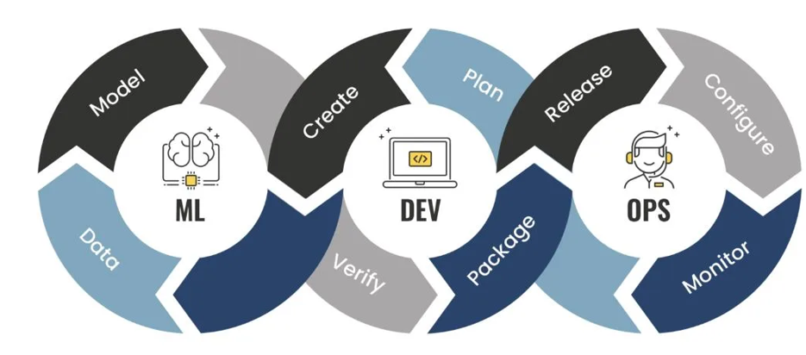
MLOps

Slide 5
Mind map
Download data (DBS.csv)
Upload to cloud #1 PythonAnywhere
Upload to cloud #2 render.com
Create Machine Learning Model and Validation (using Python Colab)
Create front end using HTML (using VS Code)
Create backend using Python Flask Framework (using Conda)
Upload data to github for cloud 2 render.com

Slide 6
Case study on DBS share price prediction
Objective: A financial institution aims to predict the future prices of a particular stock to support investment decisions and optimize portfolio management.
Reasoning: By accurately predicting share prices, the institution can identify potential buying and selling opportunities, determine optimal entry and exit points, and allocate resources effectively.
Methodology: The institution collects and analyzes vast amounts of historical stock data, including price movements. They employ advanced machine learning algorithms and statistical models to generate accurate predictions.
Results: The share price prediction model enables the institution to make informed investment decisions, optimize their portfolio allocation, manage risk effectively, and potentially generate higher returns for their clients. This approach enhances their competitiveness in the financial market and strengthens their reputation as a trusted investment advisor.

Slide 7
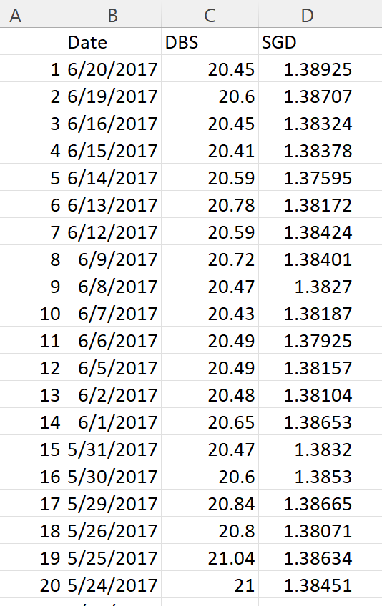
Data

Slide 8
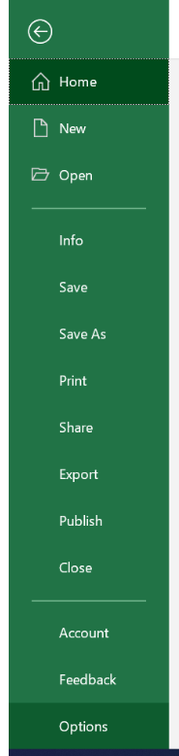
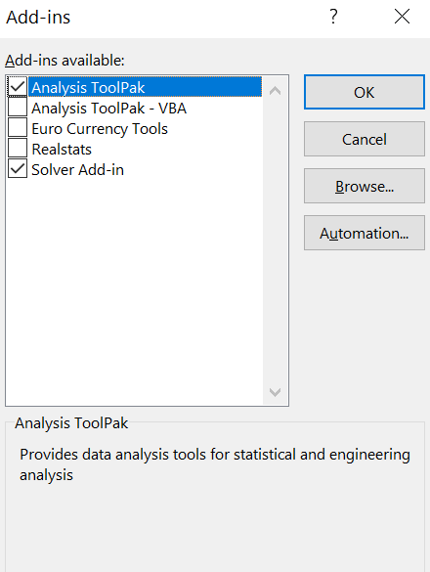
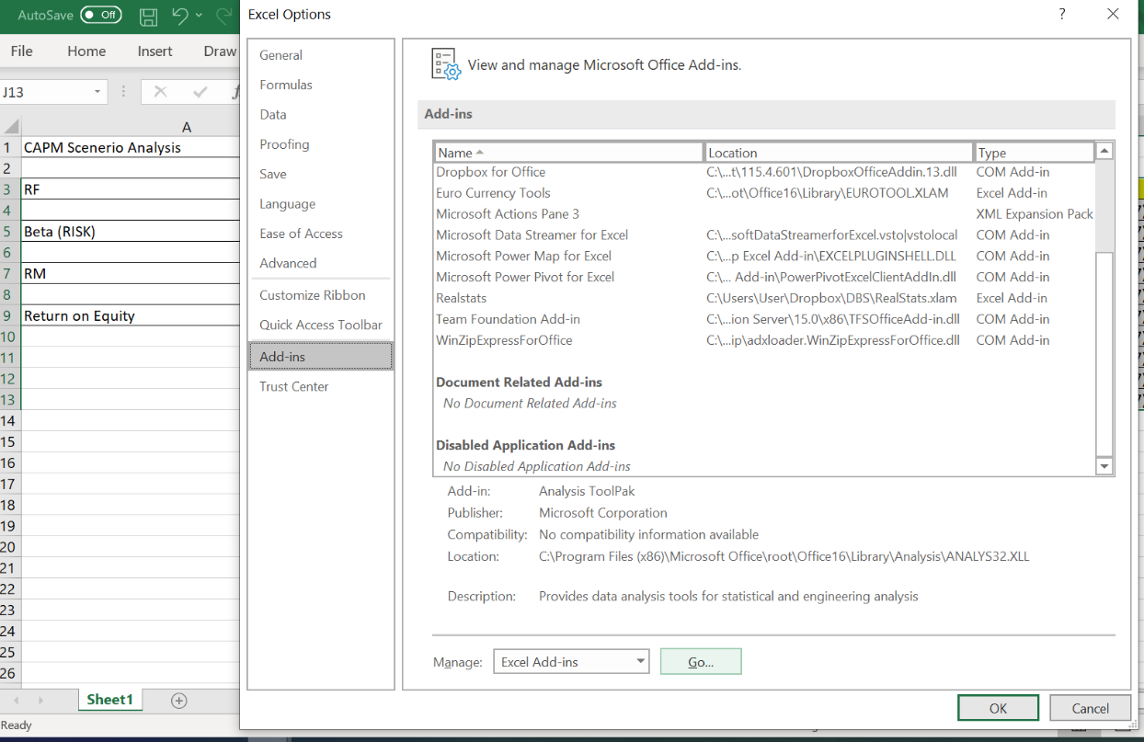
File -> Option -> Add-ins -> Manage -> Excel Add-ins - Go
Excel

Slide 9
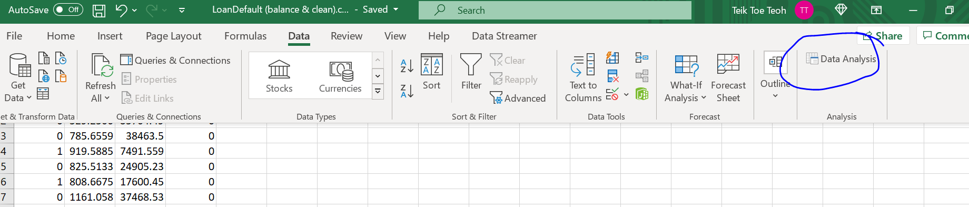
Regression on Loan Default

Slide 10
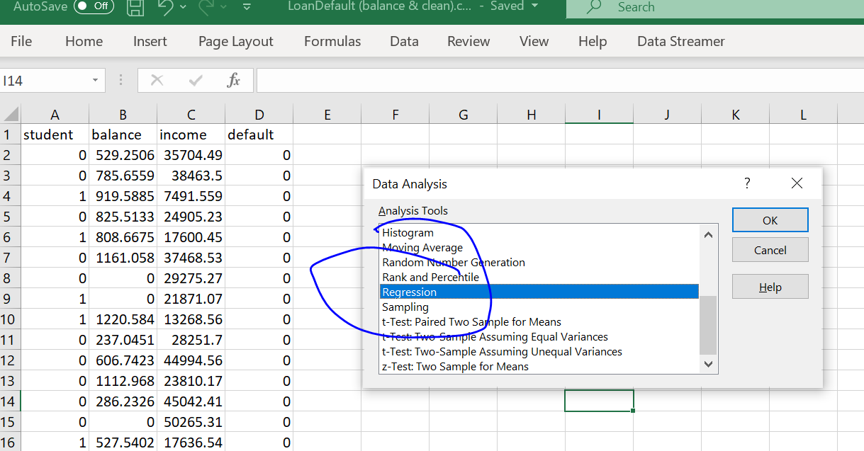
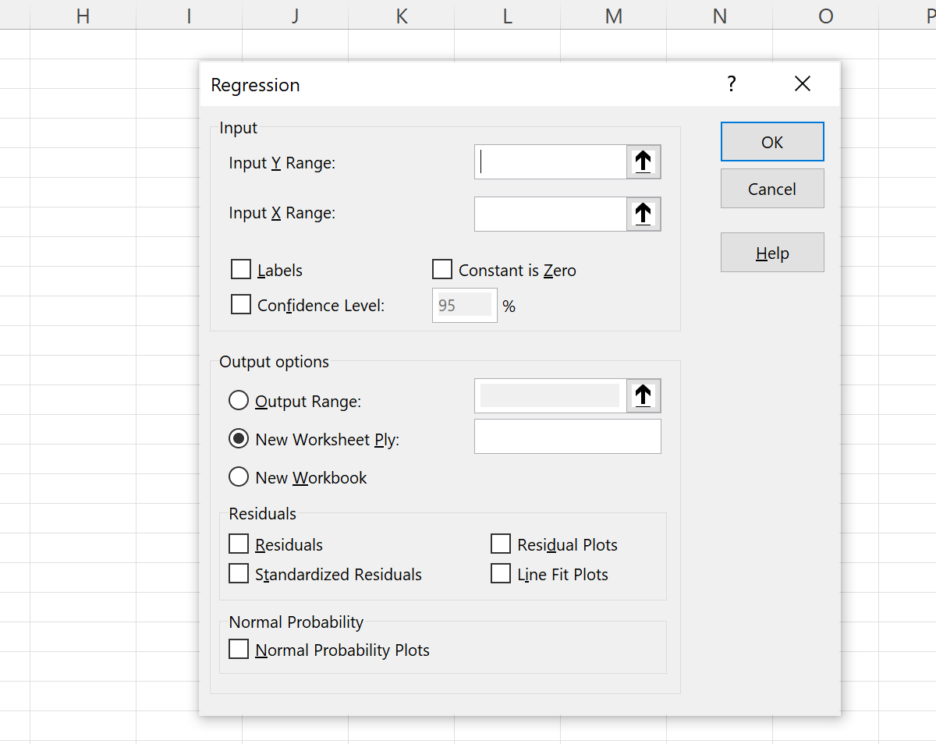
Select the range
Result will appear on new sheet

Slide 11
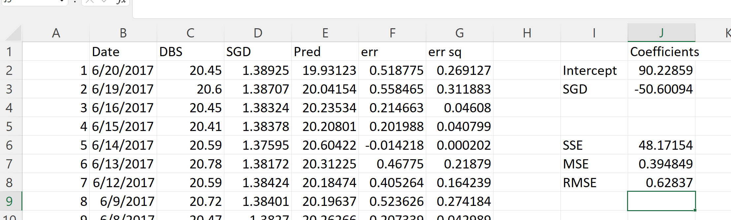
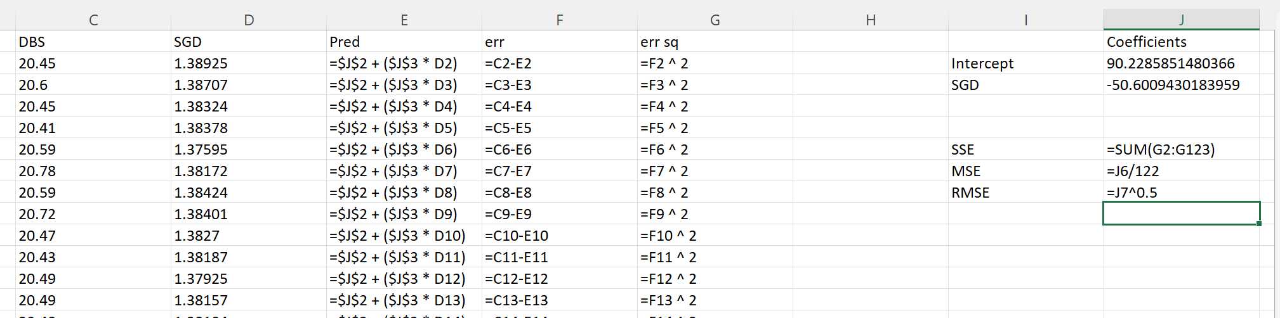

Slide 12
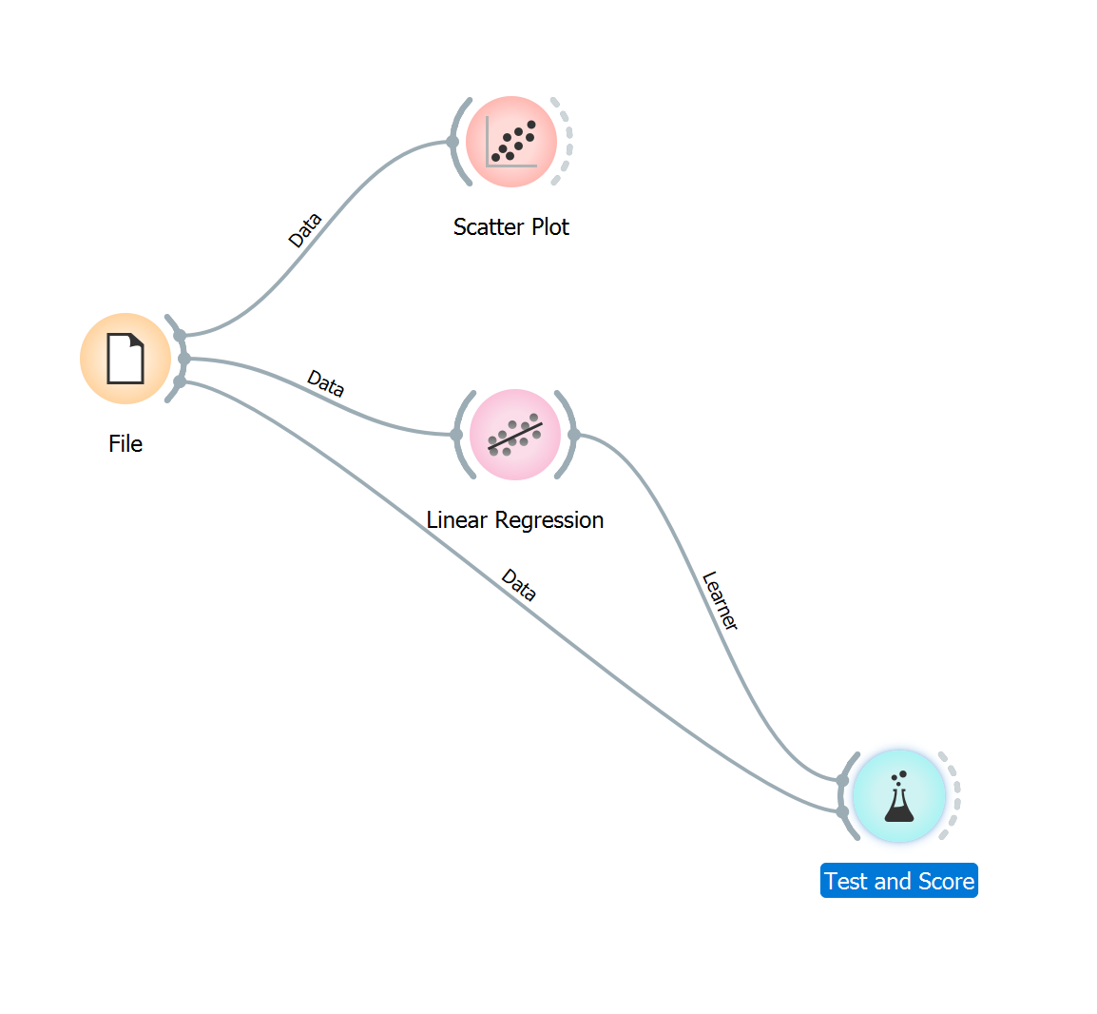
Orange

Slide 13
Python
#save model
import joblib
joblib.dump(model,”dbs.jl”)
#load model
model = joblib.load(“dbs.jl”)
import pandas as pd
df = pd.read_csv("DBS_SingDollar.csv")
X = df.loc[:,["SGD"]]
Y = df.loc[:,['DBS']]
print(X)
from sklearn import linear_model
model = linear_model.LinearRegression()
model.fit(X,Y)
pred = model.predict(X)
from sklearn.metrics import mean_squared_error
rmse = mean_squared_error(Y,pred)**0.5
print(rmse)
#print(rmse/Y.mean(axis=0)*100)
model.coef_
model.intercept_
p = model.predict([[1.35]])
#to add polynomial
df["SGD2"] = df["SGD"] ** 2

Slide 14
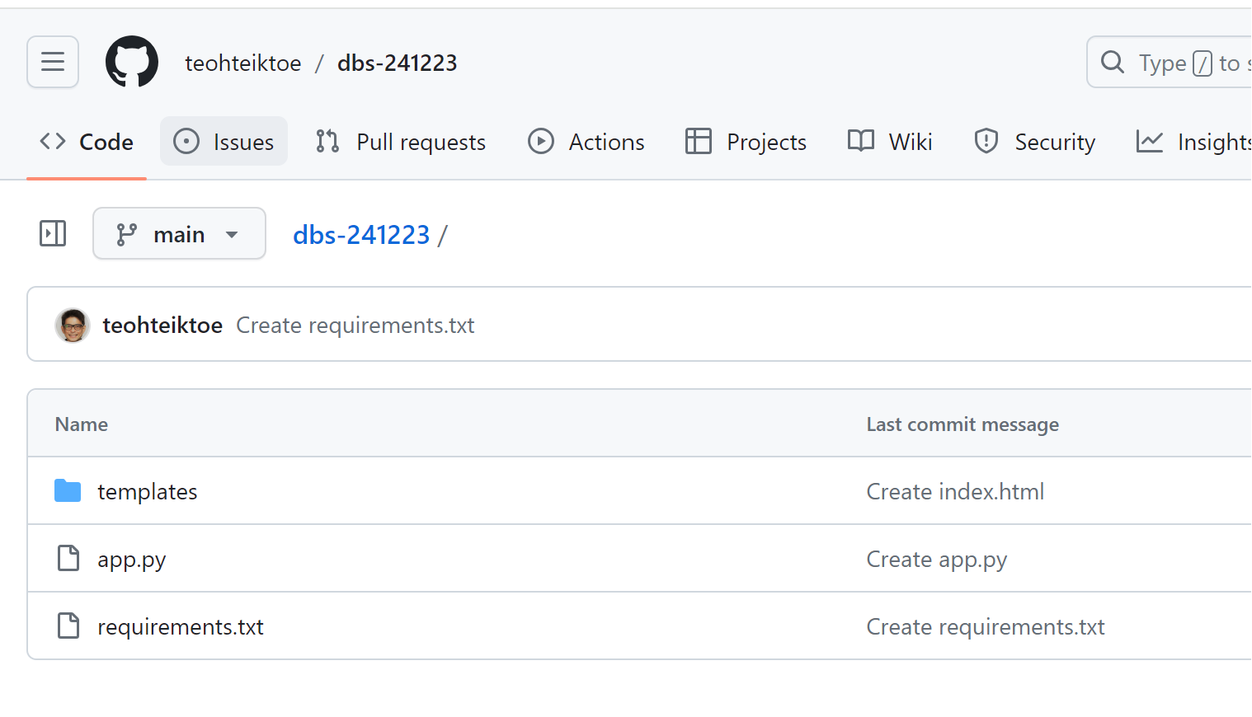
Github – create repository
requirements.txt
gunicorn
flask

Slide 15
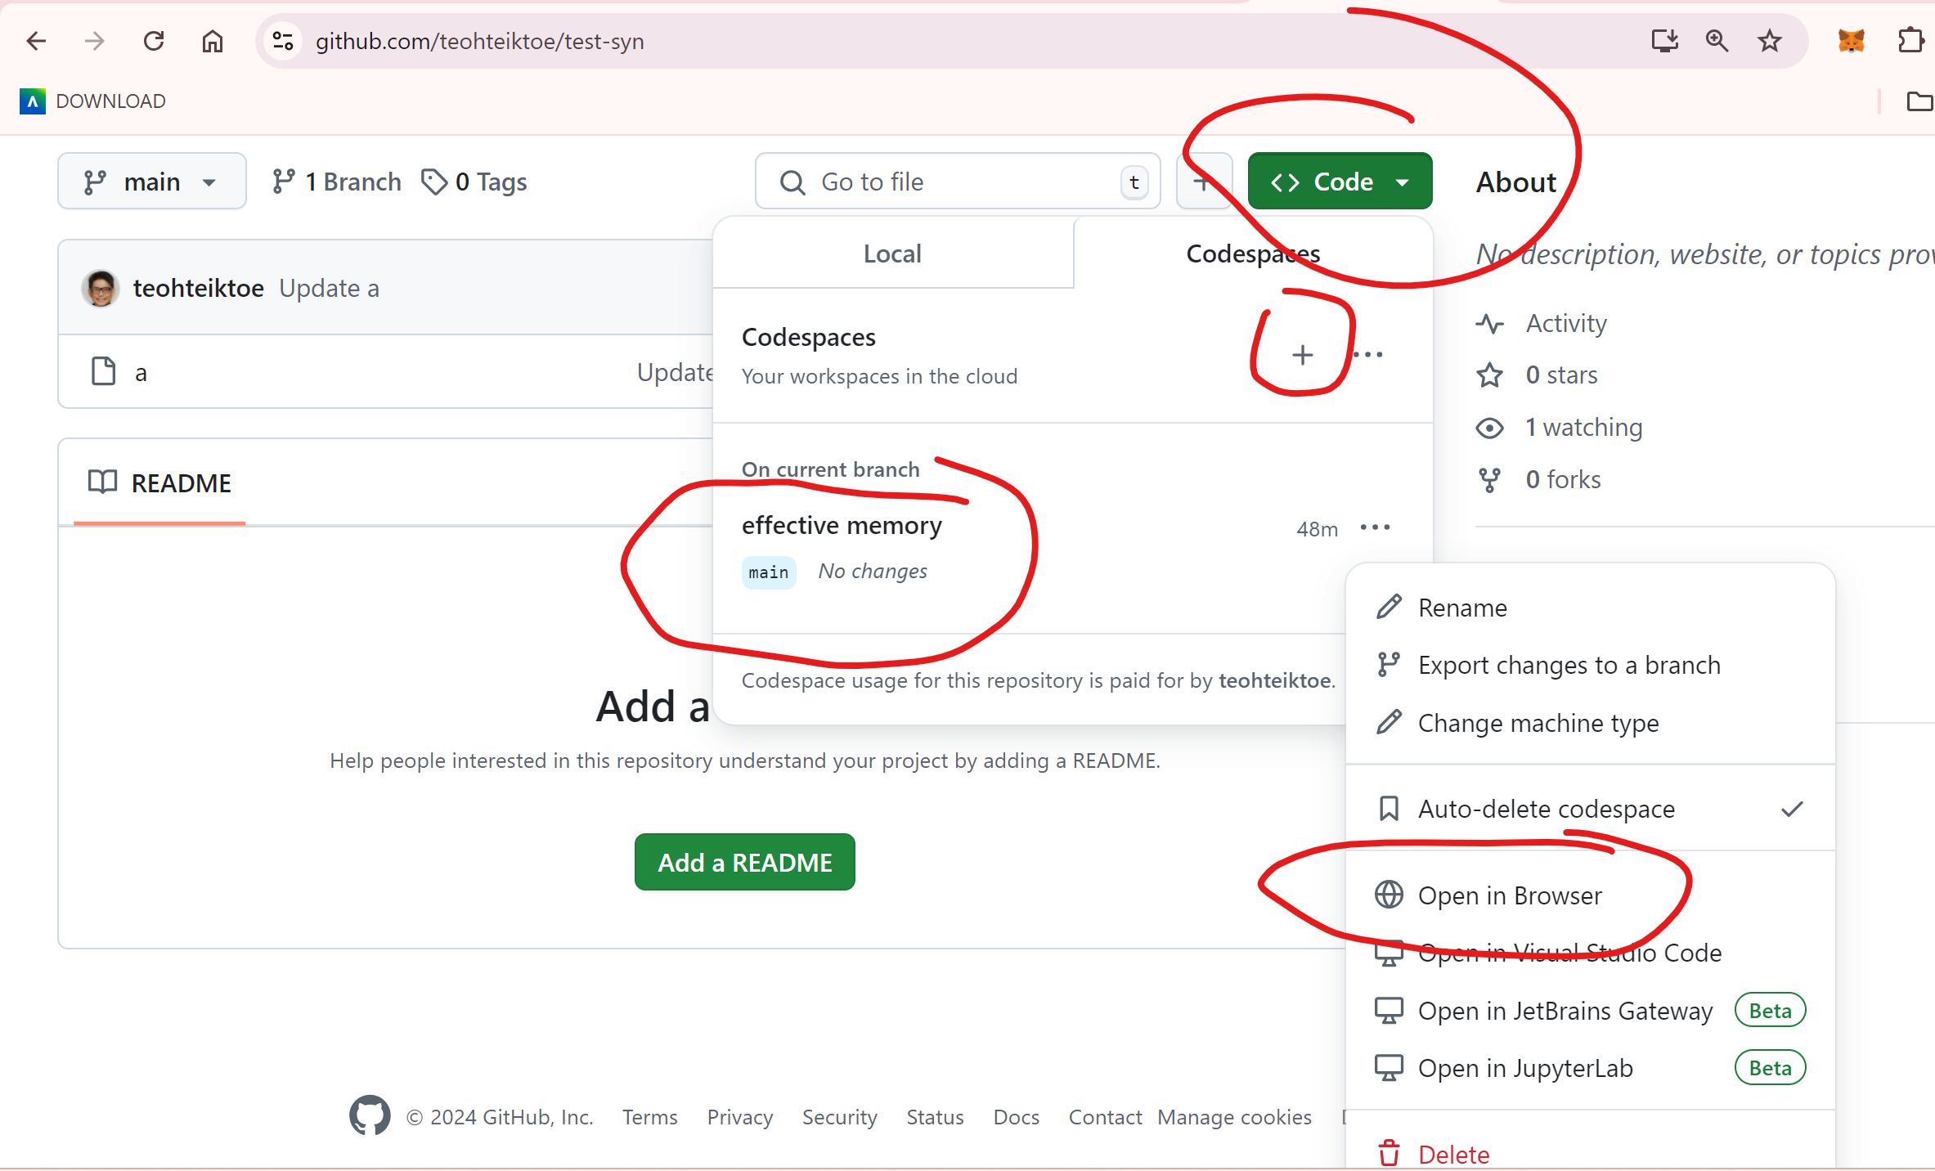
Code-spaces

Slide 16
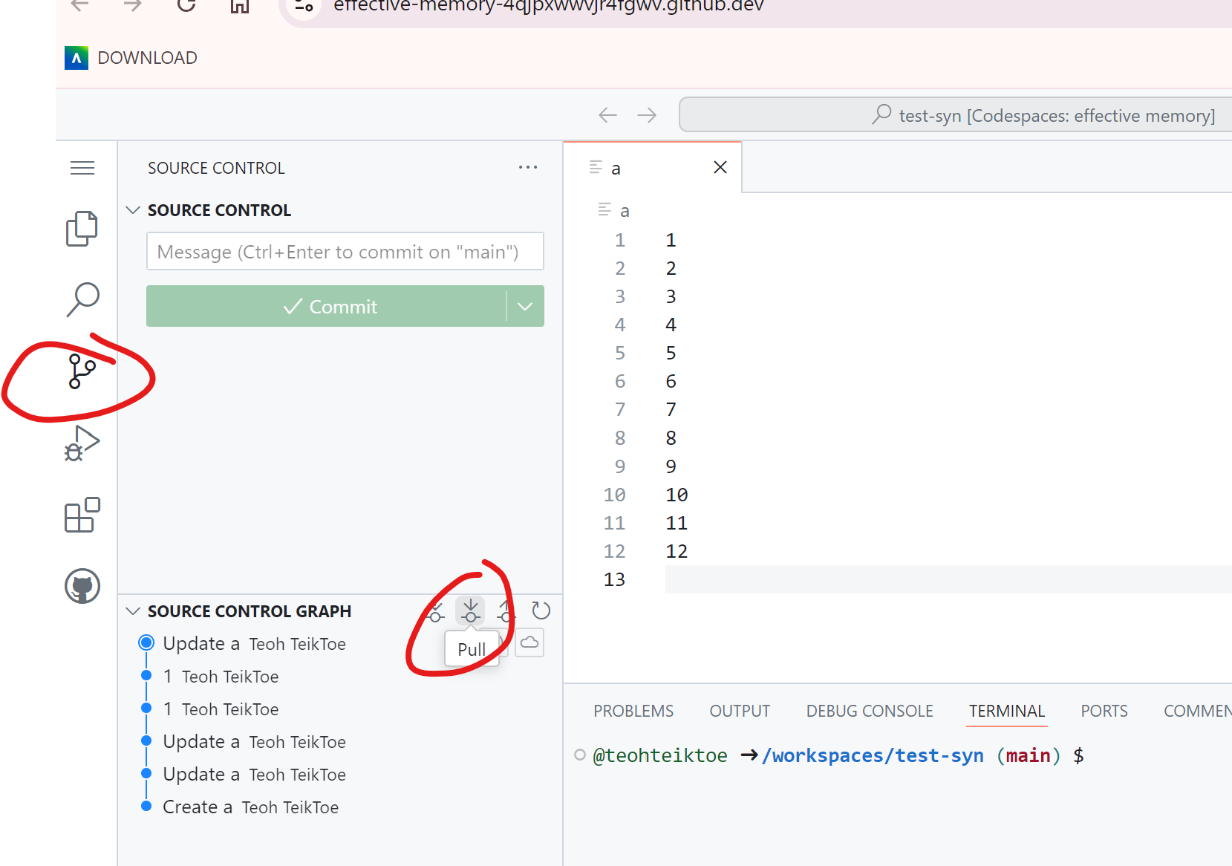
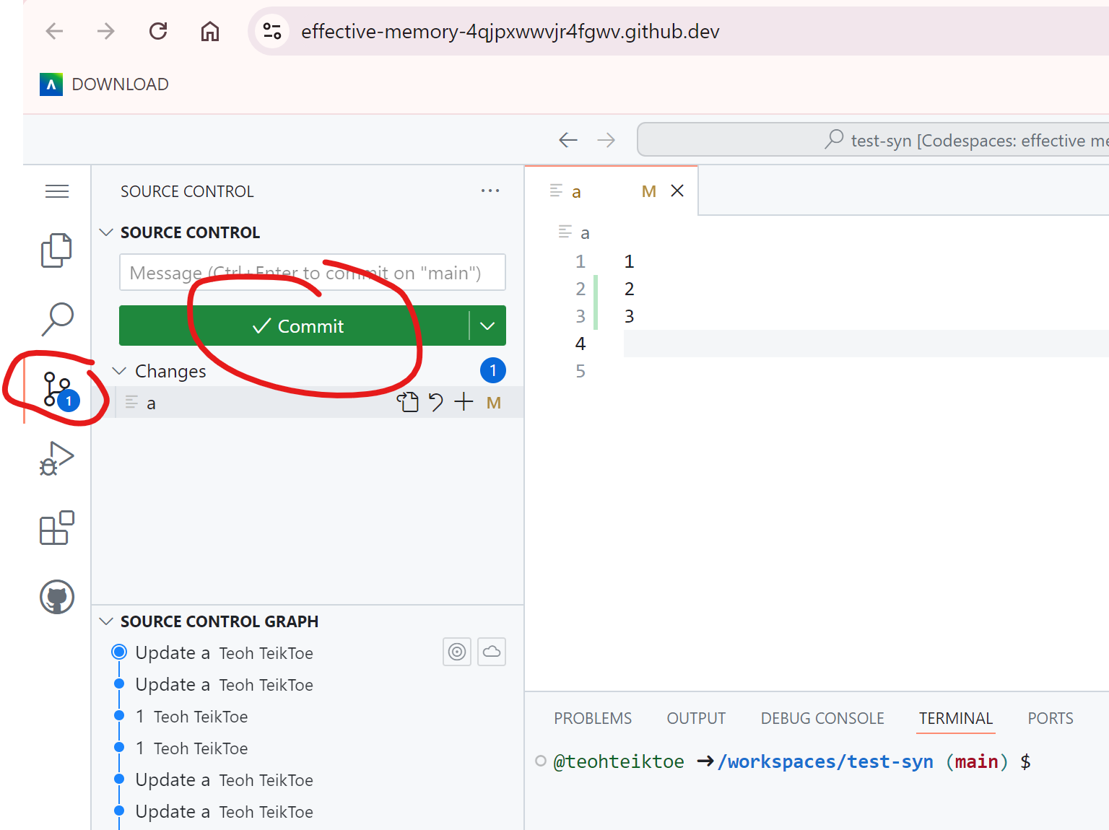
Code-spaces syn
From codeSpaces to github – need to commit then syn
From github to codeSpaces

Slide 17
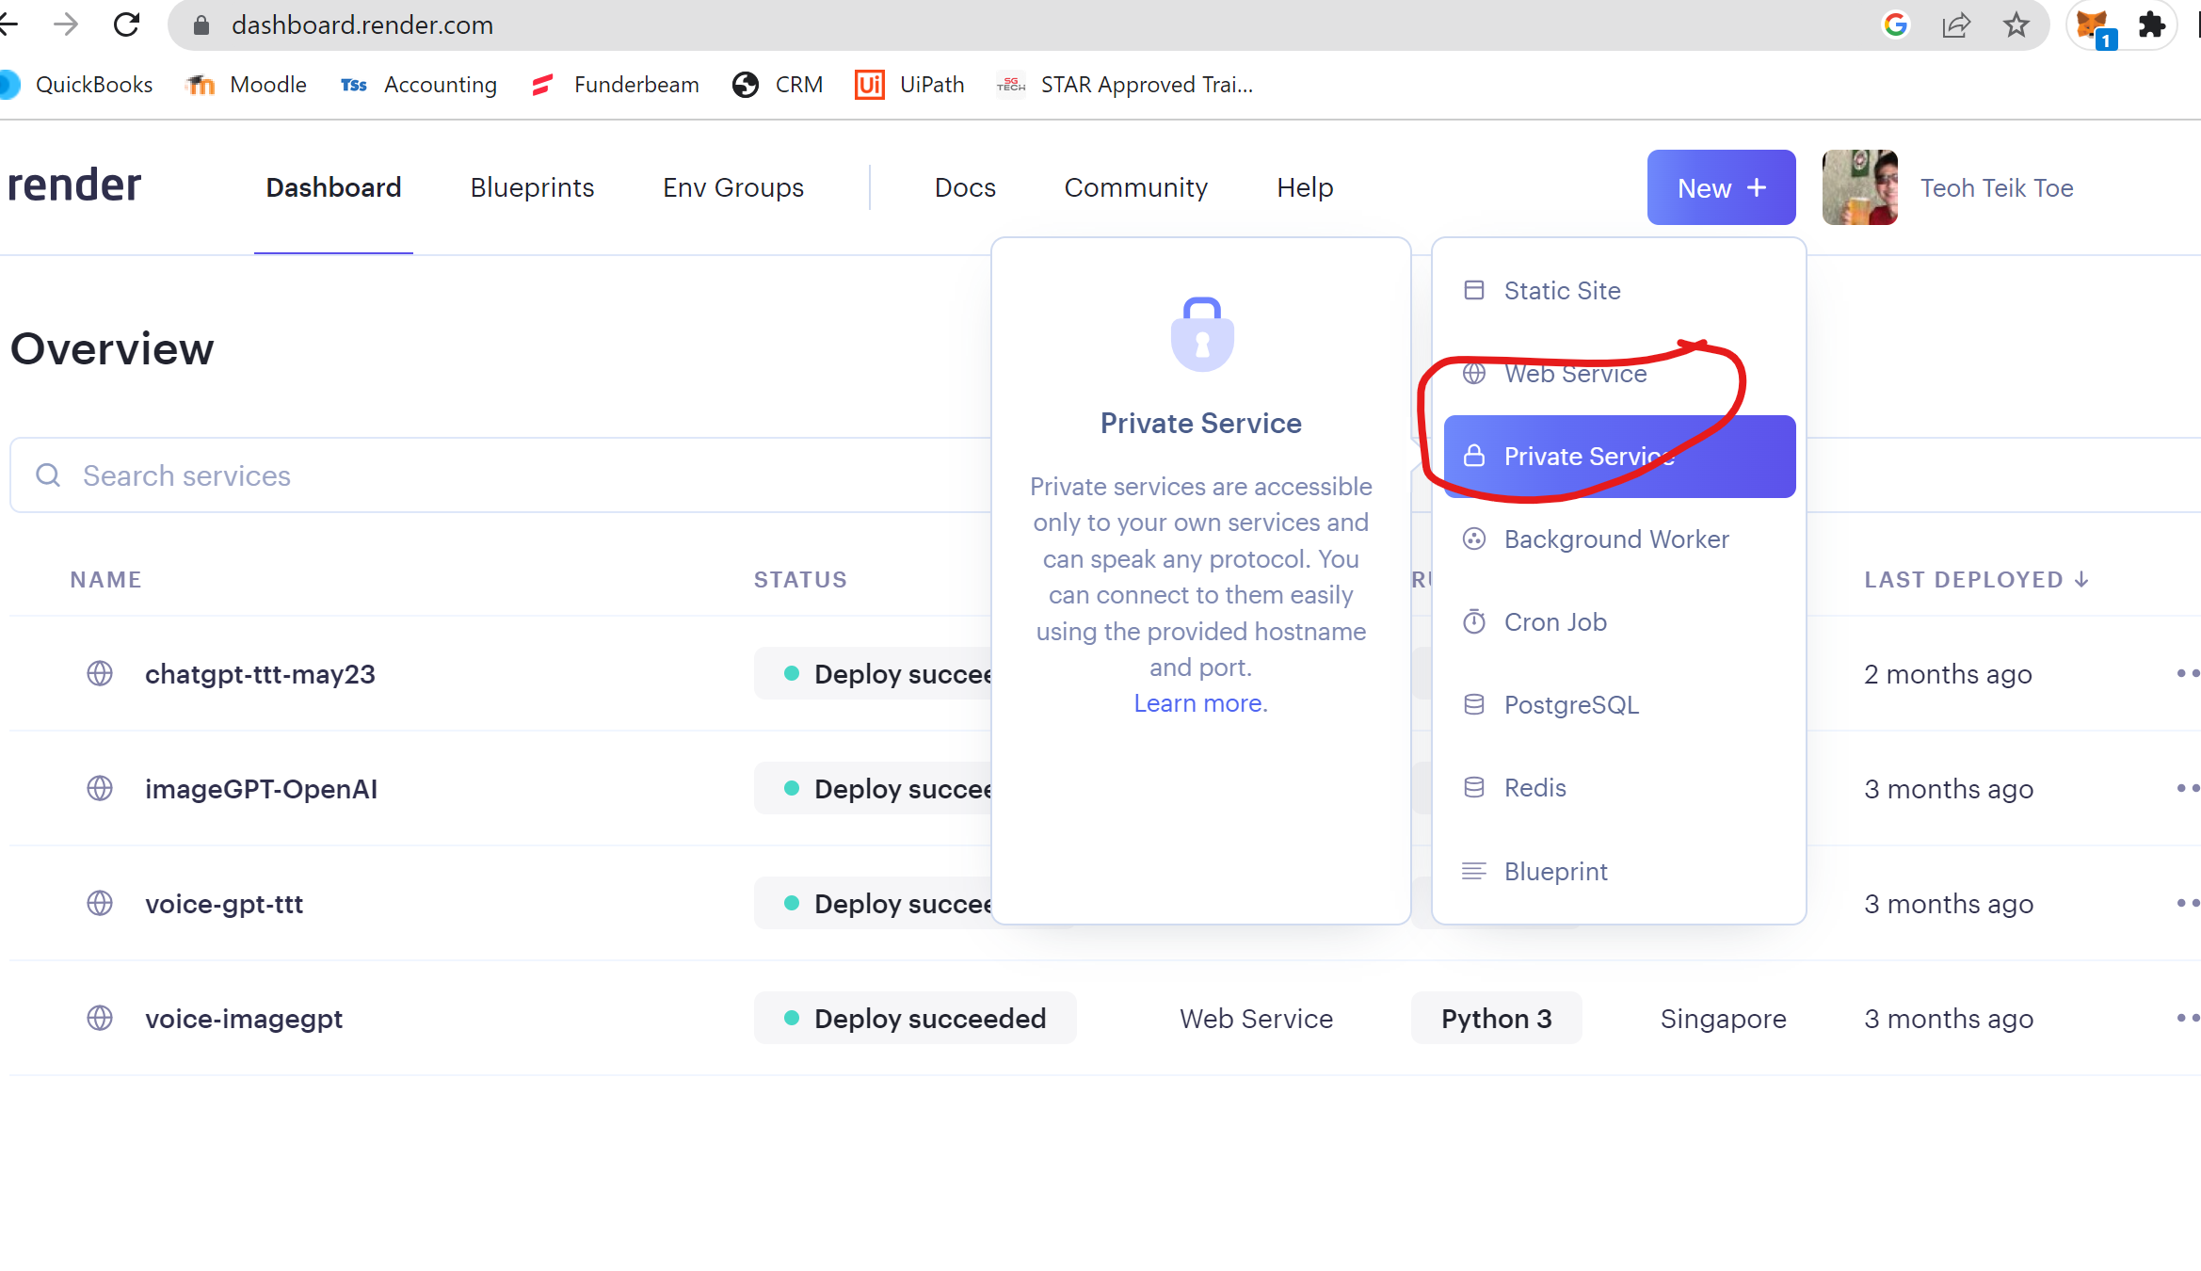
Render.com – need to create web service and link to github remember to select runtime as python3 start command - gunicorn app:app

Slide 18
app.py
app.py
from flask import Flask,render_template,request
app = Flask(__name__)
@app.route("/",methods=["GET","POST"])
def index():
return(render_template("index.html"))
@app.route("/prediction",methods=["GET","POST"])
def prediction():
q = float(request.form.get("q"))
return(render_template("prediction.html", r=(-50.6*q)+90.2))
if __name__ == "__main__":
app.run()

Slide 19
Index.html prediction.html requirements.txt
index.html
<head>
<meta name="viewport" content="width=device-width, initial-scale=1.0">
<link rel="stylesheet" href="{{ url_for('static', filename='styles.css') }}">
</head>
<body>
<div class="container">
<h2>DBS share price prediction</h2>
<form action="/prediction" method="post">
<p>Please enter USD/SGD exchange rate </p>
<input type="number" step="0.01" name="q">
<input type="submit" value="Enter">
</form>
</div>
</body>
prediction.html
<head>
<meta name="viewport" content="width=device-width, initial-scale=1.0">
<link rel="stylesheet" href="{{ url_for('static', filename='styles.css') }}">
</head>
<body>
<div class="container">
<h2>Predicted DBS share price : {{r}}</h2>
<form action="/" method="post">
<input type="submit" value="Main">
</form>
</div>
</body>
requirements.txt
gunicorn
flask
Styles.css
https://1drv.ms/u/s!Aik2a4x7tvLymZ5z6m5nmFBF9z35lg?e=HHty0F

Slide 20
styles.css
body {
font-family: 'Arial', sans-serif;
background-color: #f0f0f0;
margin: 0;
padding: 20px;
display: flex;
justify-content: center;
align-items: center;
height: 100vh;
}
.container {
background-color: #ffffff;
padding: 30px;
border-radius: 8px;
box-shadow: 0 4px 8px rgba(0, 0, 0, 0.1);
max-width: 400px;
width: 100%;
text-align: center;
}
.image-class {
max-width: 100%; /* Ensures the image scales down responsively */
height: auto; /* Maintains the aspect ratio of the image */
border-radius: 8px; /* Optional: Adds rounded corners */
margin-bottom: 20px; /* Adds space below the image */
display: block;
}
h2 {
font-size: 24px;
margin-bottom: 20px;
color: #333;
}
form {
margin: 15px 0;
}
input[type="submit"] {
background-color: #007bff;
color: white;
padding: 12px 24px;
border: none;
border-radius: 5px;
font-size: 18px;
cursor: pointer;
transition: background-color 0.3s ease;
width: 100%;
max-width: 300px;
}
input, button {
width: 100%;
padding: 10px;
margin-top: 10px;
border-radius: 4px;
border: 1px solid #ddd;
font-size: 16px;
}
button {
background-color: #007bff;
color: white;
border: none;
cursor: pointer;
}
button:hover {
background-color: #0056b3;
}
p {
margin-top: 20px;
font-size: 18px;
color: #007bff;
}
@media (max-width: 768px) {
.container {
padding: 20px;
}
h2 {
font-size: 20px;
}
input, button {
font-size: 14px;
}
p {
font-size: 16px;
}
}
https://1drv.ms/u/s!Aik2a4x7tvLymZ5z6m5nmFBF9z35lg?e=HHty0F

Slide 21
Google - gemini
pip install google-generativeai
import google.generativeai as genai
import os
from google.colab import userdata
api = userdata.get('makersuite')
genai.configure(api_key=api)
model = genai.GenerativeModel("gemini-1.5-flash")
r = model.generate_content("describe singapore.")
print(print(r.candidates[0].content.parts[0].text))

Slide 22
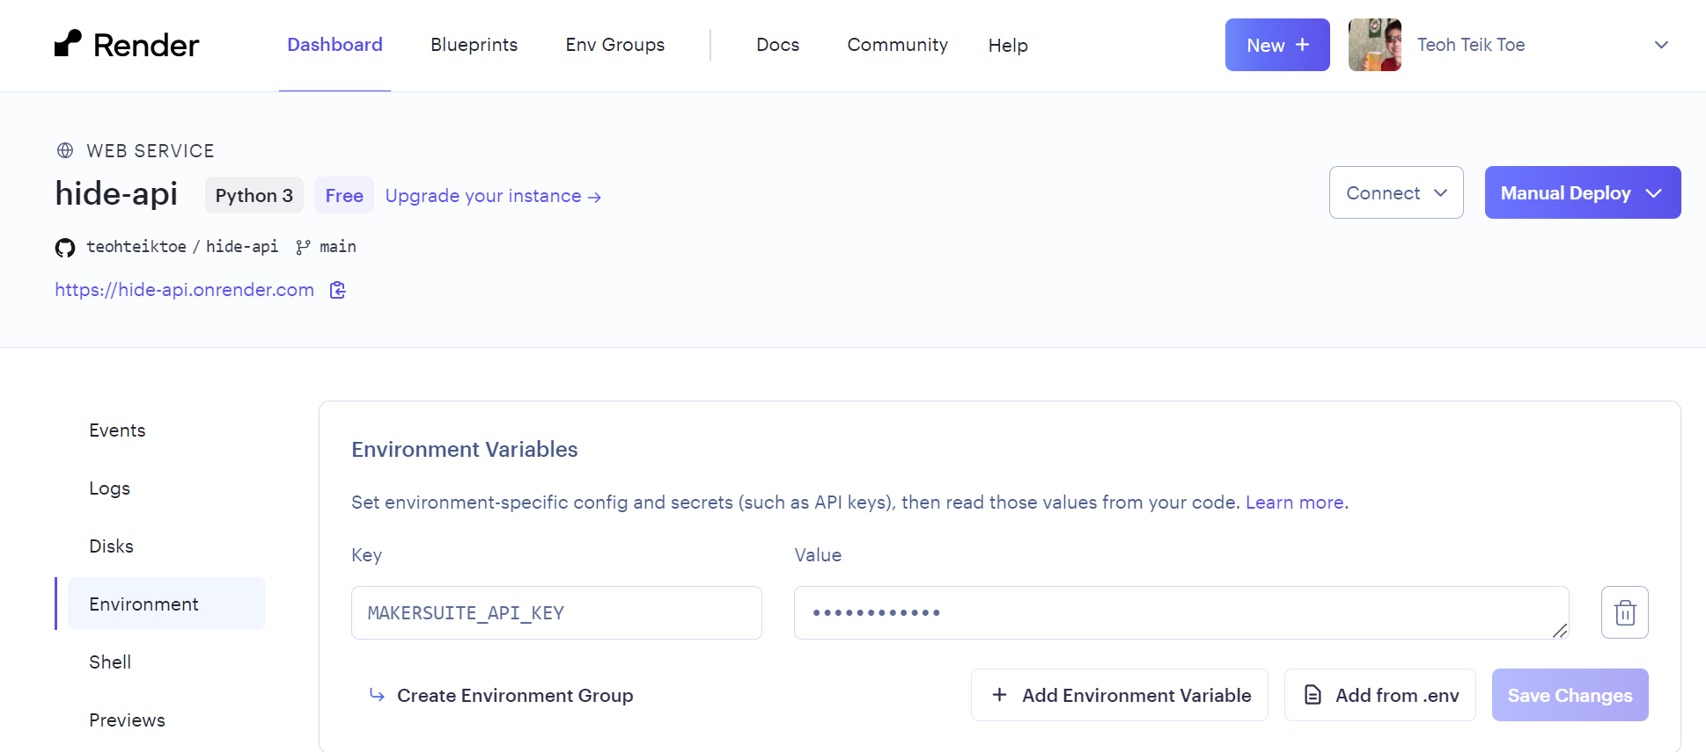
To hide API
import os
makersuite_api_key = os.getenv('MAKERSUITE_API_KEY')

Slide 23
Javascript – multiple line ‘line1’ + ‘line2'
https://drive.google.com/drive/folders/1nExv1W-uXJWRNDaE4YkLtNMkuqcJmUup?usp=drive_link
type 1
<button onclick="showMessage()">Joke!</button>
<script>
function showMessage() {
alert('Hello, welcome to the simple JavaScript example!');
}
</script>
Recording:
https://1drv.ms/v/s!Aik2a4x7tvLyjMIqgTYovzPfVeqQYA?e=52bpFj
<body>
<script src="{{url_for('static', filename='script.js')}}"></script>
</body>
In script.js file
function showMessage() {
alert('Hello, welcome to the simple JavaScript example 2!');
}
type 2

Slide 24
Declare global
first_time = 1
name = ""
@app.route("/",methods=["GET","POST"])
def index():
return(render_template("index.html"))
@app.route("/main",methods=["GET","POST"])
def main():
global first_time, name
if first_time == 1:
name = request.form.get("name")
first_time = 0
return(render_template("main.html",r=name))
def end():
global change_name_flag
change_name_flag = 1
return(render_template("index.html",r=name))

Slide 25
SQL
import sqlite3
import datetime
conn = sqlite3.connect(‘user.db')
conn.execute('CREATE TABLE user (name text, timestamp timestamp)')
conn.close()
#check
conn = sqlite3.connect(’user.db')
c = conn.cursor()
c.execute('select * from user')
print(c.description)
c.close
conn.close()
https://colab.research.google.com/drive/1cqxSAaPmQnFWhp7ie9DpHMmxgewmlQAZ?usp=drive_link
name= input("Enter name: ")
requirements.txt
gunicorn
Flask==2.3.1
pysqlite3
t = datetime.datetime.now()
t
conn = sqlite3.connect(‘user.db')
c = conn.cursor()
c.execute('INSERT INTO user (name,timestamp) VALUES(?,?)',(name,t))
conn.commit()
c.close()
conn.close()
conn = sqlite3.connect(‘user.db’)
c = conn.cursor()
c.execute('''select *
from user''')
r=""
for row in c:
print(row)
r = r + str(row)
c.close()
conn.close()
conn = sqlite3.connect(‘user.db')
c = conn.cursor()
c.execute('DELETE FROM user',);
conn.commit()
c.close()
conn.close()

Slide 26
optional

Slide 27
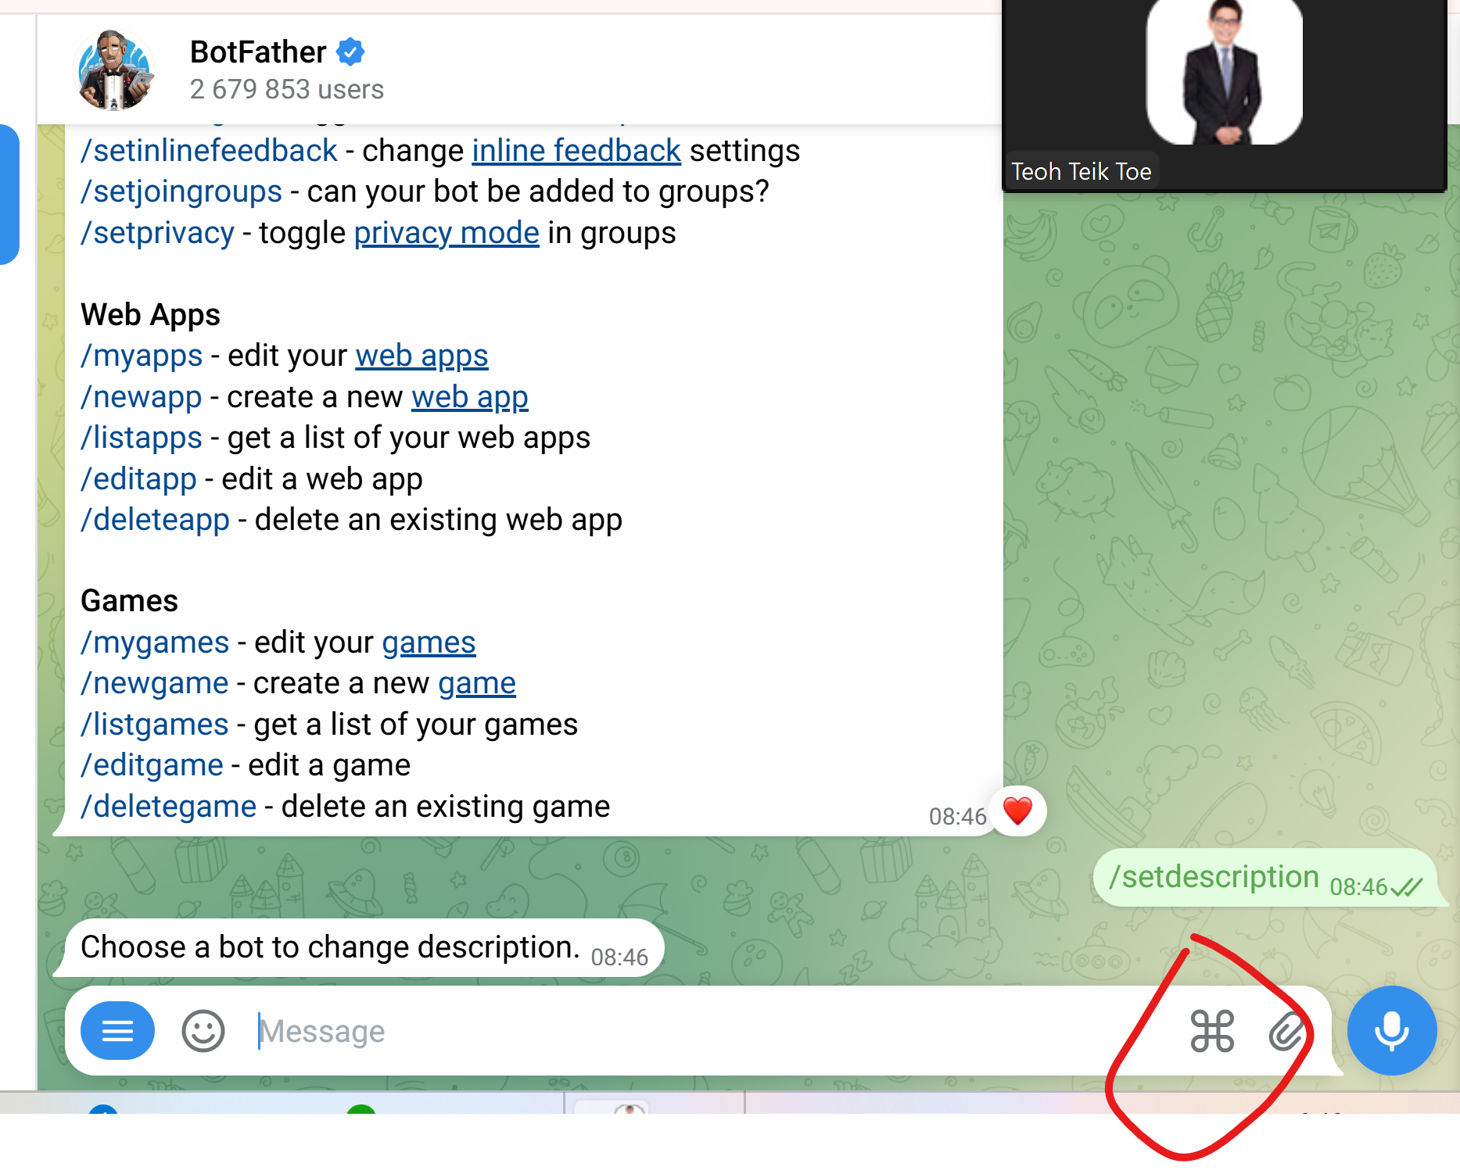
Telegram - https://web.telegram.org/
https://drive.google.com/drive/folders/1uiE4OisXVkKOemjqp8tyF1NL9X9QqVPy?usp=drive_link
@botfather
/help
/newbot
/setdescription
/
Telegram Connection Recordings: https://1drv.ms/v/s!Aik2a4x7tvLynJwTPY24OxQn9YX5Dw?e=bgUlMs
Telegram Food Expenditure Prediction Recording: https://1drv.ms/v/s!Aik2a4x7tvLynJ1Ju1yZuRjLJpWQUg?e=48qSej
Telegram CLOUD Food Expenditure Prediction Recording: https://1drv.ms/v/s!Aik2a4x7tvLynJ1PQVmmqbhlun3DMQ?e=EW6qcV
Telegram Image generator Stable Diffusion Recording: https://1drv.ms/v/s!Aik2a4x7tvLynJ149Qpfn4pZWBEuEA?e=ZHswmi

Slide 28
Telegram connection
https://colab.research.google.com/drive/1f-rf6P9YizXGpM9UNR3bXtVtFlaa5Tlr?usp=drive_link
#t.me/re6013_bot
import requests
import time
TOKEN = '8148467573:AAGTQ1qMpdLBUdAxiMq5oZpKRbNDEbzz0ic'
BASE_URL = f'https://api.telegram.org/bot{TOKEN}/'
message = input("query : ")
#telegram must on and send hi after running this code
data = ""
while not data:
response = requests.get(BASE_URL + 'getUpdates')
data = response.json()["result"]
print(data)
time.sleep(5)
#send message
send_url = BASE_URL + f'sendMessage?chat_id={chat_id}&text={message}'
requests.get(send_url)
#grab id
response = requests.get(BASE_URL + 'getUpdates')
data = response.json()
text = data['result'][-1]['message']['text']
chat_id = data['result'][-1]['message']['chat']['id']
print("Text:", text)
print("Chat ID:", chat_id)
#receive message - type some message in telegram
response = requests.get(BASE_URL + 'getUpdates')
data = response.json()
text = data['result'][-1]['message']['text']
print("Text:", text)

Slide 29
Telegram while loop
last_update_id = None
while True:
offset=last_update_id
url = f"{BASE_URL}getUpdates"
if offset:
url += f"?offset={offset}"
response = requests.get(url)
updates = response.json()
if "result" in updates:
for update in updates["result"]:
if "message" in update:
#chat_id = update["message"]["chat"]["id"]
user_msg = update["message"].get("text", "")
print(f"User said: {user_msg}")
last_update_id = update["update_id"] + 1
time.sleep(2)
https://colab.research.google.com/drive/1XDfPsGbxYedjOkmqFPcj7PSKPIFQyL1Y?usp=drive_link

